Slide 1
Undergraduate Student Experience and Needs Survey
Collaboration between the Office of Provost, the Division of Diversity, Equity and Educational Achievement and the Division of Student Affairs
In the field October 27-November 10
5,328 students completed the survey
Response Rates
All Students | 17%
Female / Male students | 20% / 14%
Minority students | 13%
First generation students | 17%
Pell grant recipients | 18%

Slide 2
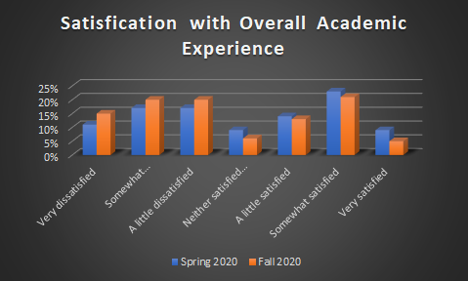
Question: How satisfied are you with your overall academic experience? (asked for both spring 2020 and fall 2020)
Means (scale is -3 to 3)
Spring 2020 | 0.02
Fall 2020 | -0.32

Slide 3
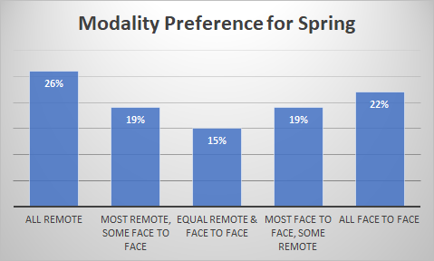
Question: Now think about the courses you plan to take in the Spring 2021 semester with less than 50 students. Which one of the following best describes the types of formats you would prefer to have in the Spring 2021 semester?

Slide 4
Question: Online and remote courses often include synchronous sessions, in which the students and instructor meet together live and at the same time for lectures or discussions using Zoom, Blackboard Collaborate, or a similar tool, and asynchronous sessions, where the instructor records a video or audio lecture and students can watch it at any time. In general, which of these learning modes has worked better for you?

Slide 5
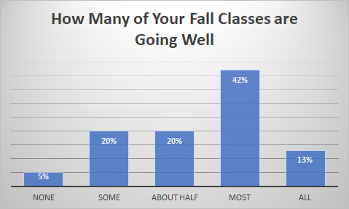
Question: Overall, how many of your courses are going well for you this semester?

Slide 6
Do you plan to enroll at UW-Madison Spring 2021?
Yes | 95%
No | 5%
Among those saying they do not plan to enroll in Spring 21
Graduating in Fall 20 | 64%
Transferring | 3%
Taking time off | 21%
Other | 12%

