Slide 1
Fall 2020 Graduate Experience Survey Results
Graduate School
University of Wisconsin, Madison
Contact: parmesh.ramanathan@wisc.edu

Slide 2
Survey Summary
Survey administered to 5423 doctoral students and 3850 Masters students (Oct 27, 2020 – Nov 16, 2020)
Response rate as Nov 11, 2020: 2735 (29.49%)
1521 Doctoral Students (28.04%)
1179 Masters Students (30.62%)
73.4% of the respondents said that they reside in United States
4.78% of the respondents said that they reside outside the United States
93.83% of those in US reside within commuting distance of Madison
42% of respondents are Male and 58% are Female
70 % US Citizens, 30 % Not US Citizens

Slide 3
Major Takeaways: Academic Progress
In the current environment, top challenges for graduate students in making academic progress are
No or limited access to field experience
Limited in-person interaction with fellow students
No or limited ability to collected face-to-face research data
Limited networking opportunities
Limited access to research office space
On the positive side,
access to required courses
access to course technology, and
access to needed software, computing, and storage resources
are not reported as major barriers to making academic progress

Slide 4
Major Takeaways: Teaching Experience
For graduate students involved in teaching,
dealing with teaching technology and
ability to provide synchronous, asynchronous, and one-on-one interaction to their students
are reported to be the biggest challenge.
On the positive side, even among students involved in teaching in-person sections, only a small fraction of TAs report challenges with
classroom facilities
teaching spaces, and
access to personal protection equipment.

Slide 5
Q6: Comfort coming to campus
Currently, how comfortable are you coming to campus for in-person activities?
For class
For research
For work
For social interaction
Responses on 5-point Likert scale
Not at all (comfortable)
A little (comfortable)
Somewhat (comfortable)
Very (comfortable)
Extremely (comfortable)

Slide 6
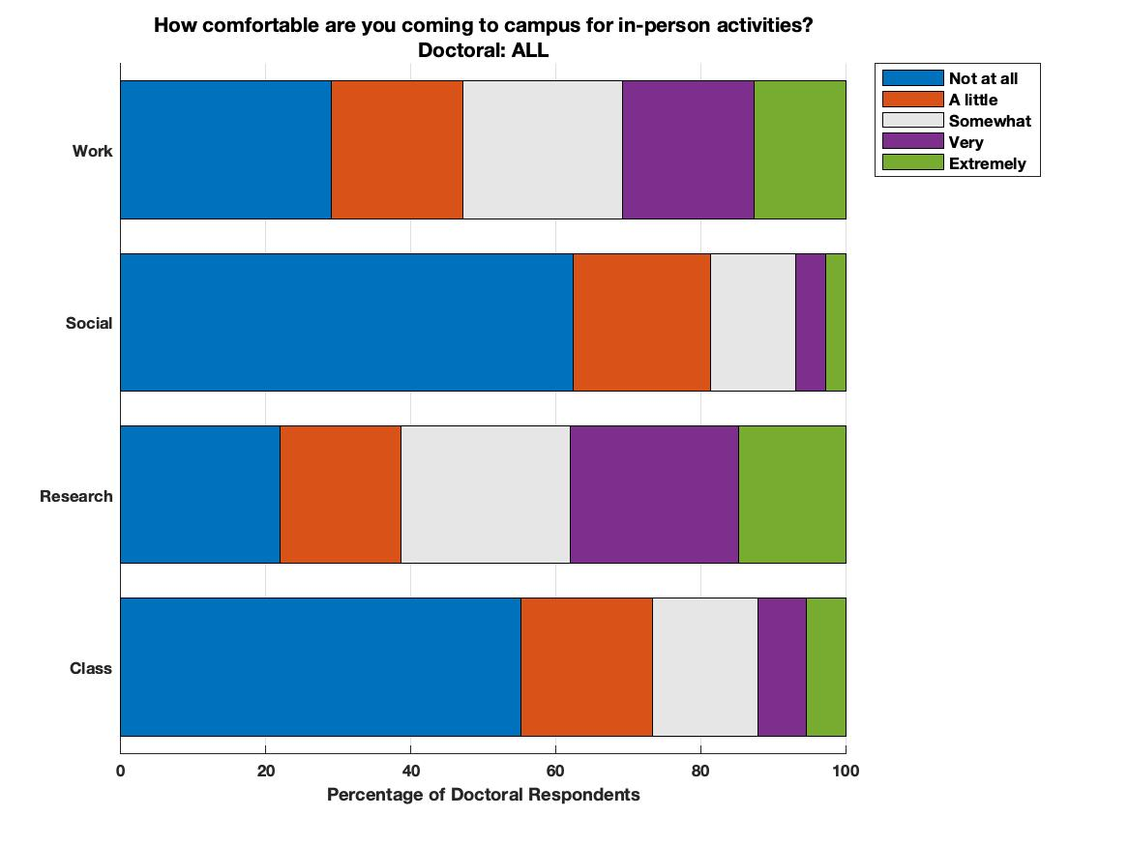
Comfortable Coming to Campus for In-person Activities (Doctoral Stu)

Slide 7
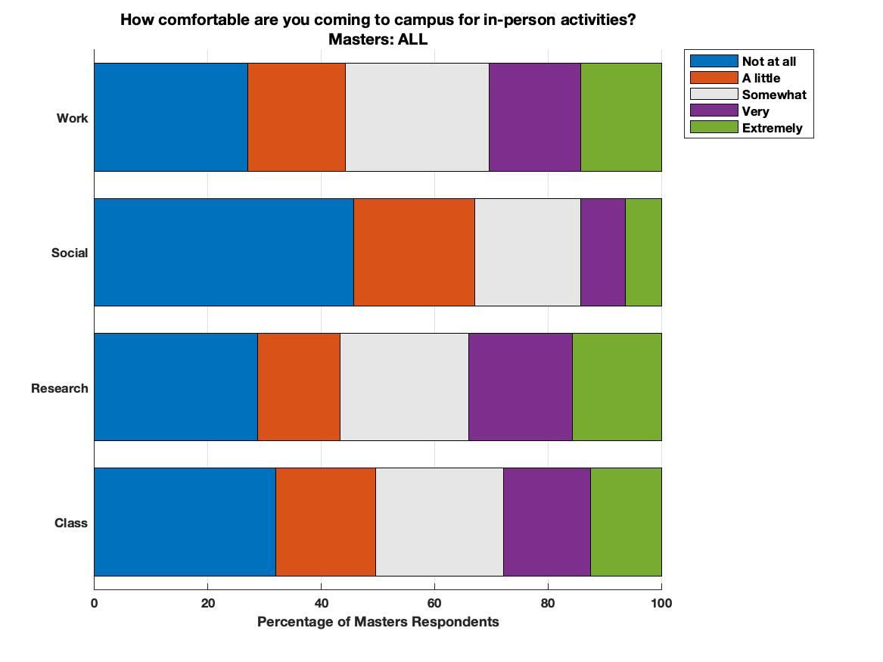
Comfortable Coming to Campus for In-person Activities (Masters Stu)

Slide 8
Comfortable coming to campus for in-person activities
Remarks
At least 40% of the respondents are not comfortable coming to campus for in-person activities.
Respondents are more comfortable coming to campus for research as compared to class, work, or social interaction
Not much difference in the responses between doctoral and Master’s students.

Slide 9
Q7,Q8: Challenges/Barriers to Academic Progress
Q7: Currently, how much are the following factors affecting your academic progress?
Q8: Currently, how much are the following factors a barrier to your academic progress?
23 different factors
Responses on 5-point Likert scale
Not at all (barrier)
A little (barrier)
Somewhat (barrier)
Quite a bit (barrier)
A great deal (barrier)

Slide 10
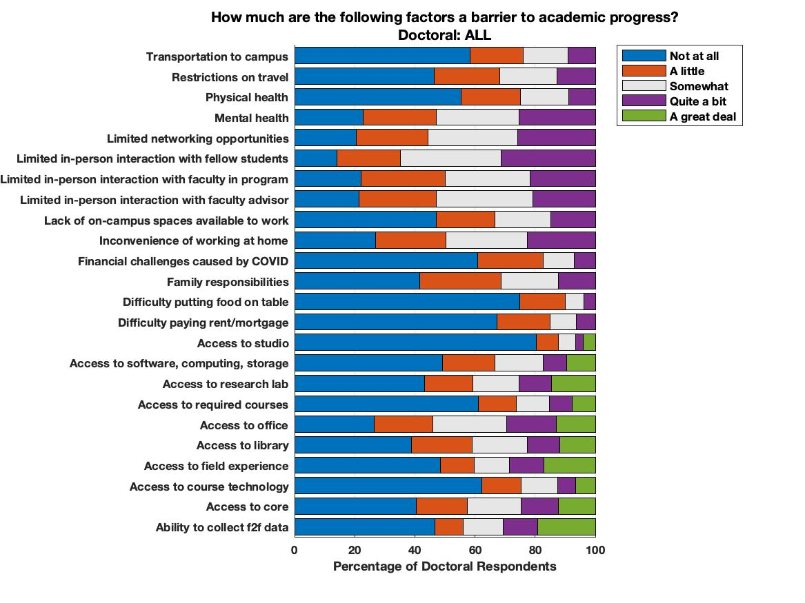
Challenges/Barriers to academic progress (Doctoral Students)

Slide 11
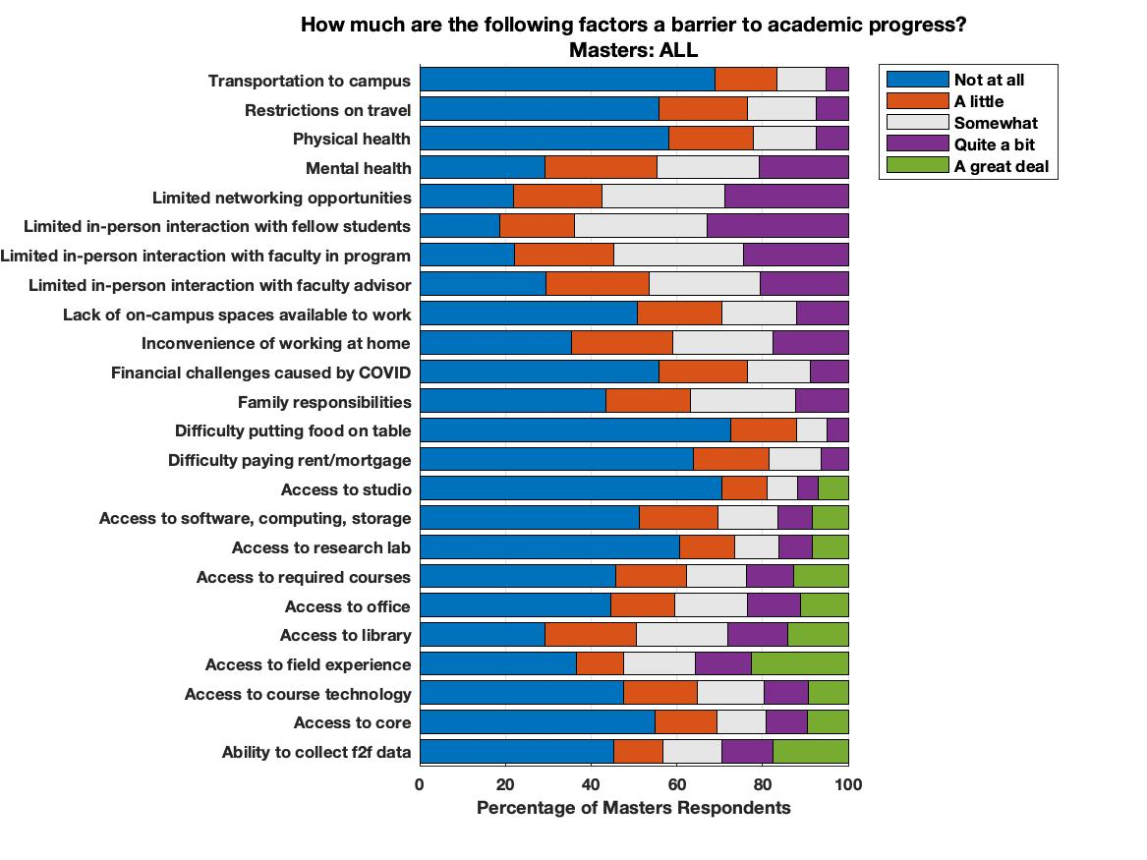
Challenges/Barriers to academic progress (Masters Students)

Slide 12
Challenges/Barriers to academic progress (Doctoral Students)
Remarks
For at least 25% of doctoral respondents the following factors were quite a bit or a great deal of challenge to academic progress
Limited interaction with fellow students
Access to field experience
Ability to collect f2f data
Limited networking opportunities
Access to office
Mental health
Access to research lab
Remarks
For at least 75% of doctoral respondents the following factors were not a or a little challenge to academic progress
Physical health
Access to course
Transportation to campus
Financial challenges caused by COVID-19
Difficult paying rent/mortgage
Access to studio
Difficulty putting food on the table

Slide 13
Challenges/Barriers to academic progress (Masters Students)
Financial challenges caused by COVID
Restrictions on travel
Physical health
Access to studio
Difficulty paying rent/mortgage
Transportation to campus
Difficulty putting food on table
Remarks
For at least 25% of Masters respondents the following factors were quite a bit or a great deal of challenge to academic progress
Access to library
Limited networking opportunities
Ability to collect f2f data
Limited in-person interaction with fellow students
Access to field experience
Remarks
For at least 75% of doctoral respondents the following factors were not a or a little challenge to academic progress
Financial challenges caused by COVID-19
Restrictions on travel
Physical health
Access to studio
Difficulty paying rent/mortgage
Transportation to campus
Difficulty putting food on table

Slide 14
Challenges to teaching a course as a teaching assistant
In teaching the course, how much are the following factors a challenge?
10 factors
Responses on 5-point Likert scale
Not at all (challenge)
A little (challenge)
Somewhat (challenge)
Quite a bit (challenge)
A great deal (challenge)

Slide 15
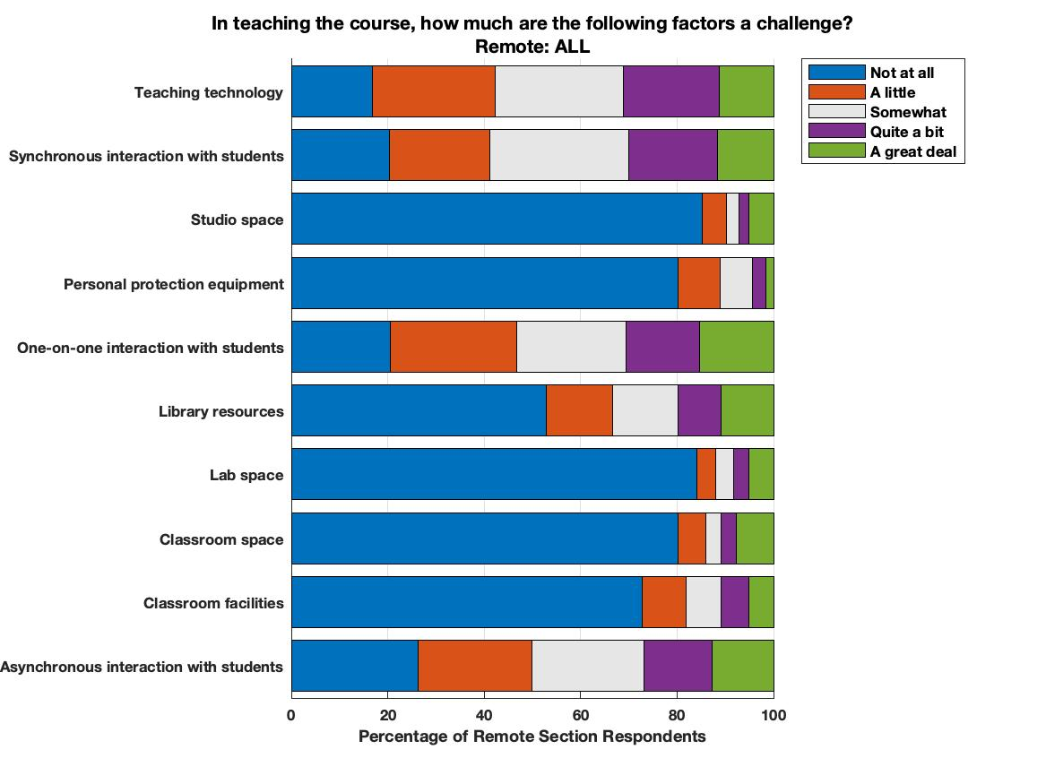
Challenges to teaching (TA) Remote Sections

Slide 16
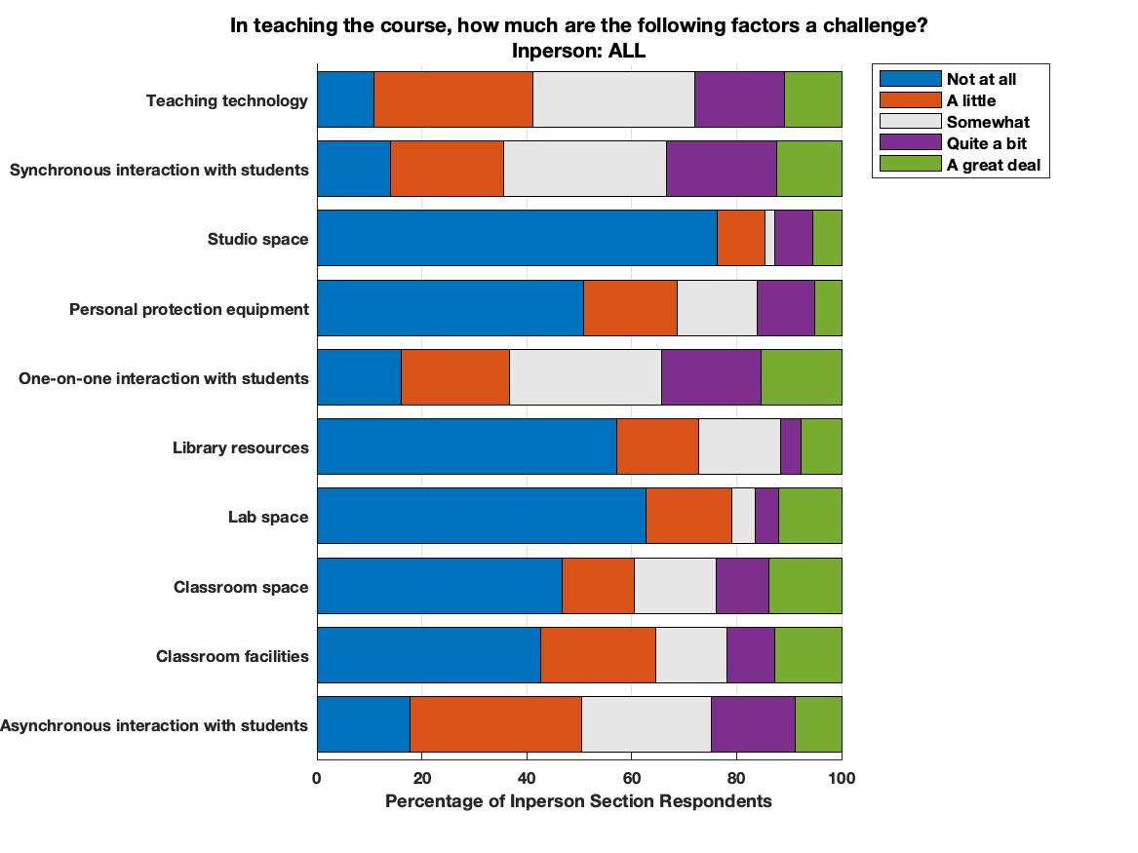
Challenges to teaching (TA) In-person Sections

Slide 17
Challenges to teaching course (Remote sections)
Remarks
For at least 25% of remote section TA respondents the following factors were quite a bit or a great deal of challenge to academic progress
Teaching technology
Asynchronous interaction with students
Synchronous interaction with students
One-on-one interaction with students
Remarks
For at least 75% of remote section respondents the following factors were not a or a little challenge to academic progress
PPE
Classroom facilities
Classroom space
Lab space
Studio space

Slide 18
Challenges to teaching course (In-person sections)
Remarks
For at least 25% of remote section TA respondents the following factors were quite a bit or a great deal of challenge to academic progress
Teaching technology
Synchronous interaction with students
One-on-one interaction with students
Remarks
For at least 75% of in-person section respondents the following factors were not a or a little challenge to academic progress
Lab space
Studio space

